Slide 1

Apache Hive with Hadoop
March 30, 2020

Slide 2
Apache Hive with Hadoop
Hadoop Overview
Hive Overview
Practical Information
File Format
Theory
Lab and next time
Notes:
Bullet Points

Slide 3
What is Hadoop?
Open-source framework that enables distributed processing of data across clusters of computers using simple programming models
Designed to scale from a single machine to thousands of machines
Rather than rely on the hardware for high availability, the library detects and handles failures
Delivers a highly-available service on top of a cluster of machines that are prone to failure
Parent project to several widely used modules
Notes:
Bullet Points

Slide 4
Hadoop Modules
Hadoop Common: The common utilities that support the other Hadoop modules
Hadoop Distributed File System (HDFS™): A distributed file system that provides high-throughput access to application data
Hadoop YARN: A framework for job scheduling and cluster resource management
Hadoop MapReduce: A YARN-based system for parallel processing of large data sets
Hadoop Ozone: An object store for Hadoop
Notes:
Bullet Points

Slide 5
Hadoop Distributed File System (HDFS™)
Stores data across multiple machines
Designed to store large files
Files are split into blocks
Blocks are replicated across different nodes in the cluster
Many Big Data projects store their data in HDFS (Hive, HBase etc.)
Using HDFS:
Connect via APIs in your application (Java, Python, Scala, Golang etc.)
Within web UI like Ambari
Directly via the command line:
hdfs dfs -ls /tmp
hdfs dfs -mkdir /user/bob/mydata
Notes:
Assumptions and Goals
Hardware Failure
Hardware failure is the norm rather than the exception. An HDFS instance may consist of hundreds or thousands of server machines, each storing part of the file system’s data. The fact that there are a huge number of components and that each component has a non-trivial probability of failure means that some component of HDFS is always non-functional. Therefore, detection of faults and quick, automatic recovery from them is a core architectural goal of HDFS.
Streaming Data Access
Applications that run on HDFS need streaming access to their data sets. They are not general purpose applications that typically run on general purpose file systems. HDFS is designed more for batch processing rather than interactive use by users. The emphasis is on high throughput of data access rather than low latency of data access. POSIX imposes many hard requirements that are not needed for applications that are targeted for HDFS. POSIX semantics in a few key areas has been traded to increase data throughput rates.
Large Data Sets
Applications that run on HDFS have large data sets. A typical file in HDFS is gigabytes to terabytes in size. Thus, HDFS is tuned to support large files. It should provide high aggregate data bandwidth and scale to hundreds of nodes in a single cluster. It should support tens of millions of files in a single instance.
Simple Coherency Model
HDFS applications need a write-once-read-many access model for files. A file once created, written, and closed need not be changed. This assumption simplifies data coherency issues and enables high throughput data access. A MapReduce application or a web crawler application fits perfectly with this model. There is a plan to support appending-writes to files in the future.
“Moving Computation is Cheaper than Moving Data”
A computation requested by an application is much more efficient if it is executed near the data it operates on. This is especially true when the size of the data set is huge. This minimizes network congestion and increases the overall throughput of the system. The assumption is that it is often better to migrate the computation closer to where the data is located rather than moving the data to where the application is running. HDFS provides interfaces for applications to move themselves closer to where the data is located.
Portability Across Heterogeneous Hardware and Software Platforms
HDFS has been designed to be easily portable from one platform to another. This facilitates widespread adoption of HDFS as a platform of choice for a large set of applications.

Slide 6
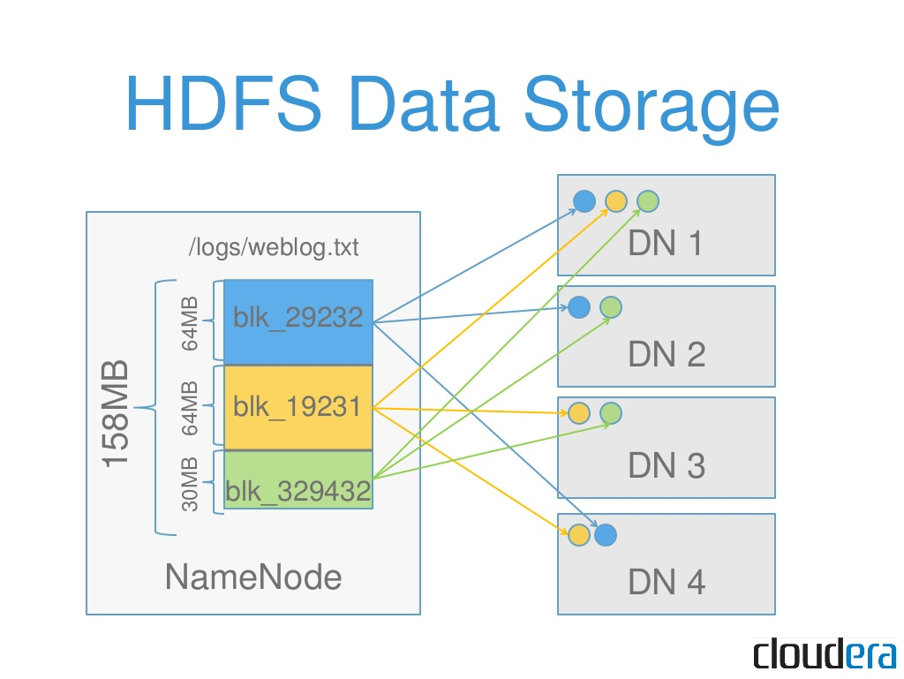
Hadoop Distributed File System (HDFS™)
Notes:
Assumptions and Goals
Hardware Failure
Hardware failure is the norm rather than the exception. An HDFS instance may consist of hundreds or thousands of server machines, each storing part of the file system’s data. The fact that there are a huge number of components and that each component has a non-trivial probability of failure means that some component of HDFS is always non-functional. Therefore, detection of faults and quick, automatic recovery from them is a core architectural goal of HDFS.
Streaming Data Access
Applications that run on HDFS need streaming access to their data sets. They are not general purpose applications that typically run on general purpose file systems. HDFS is designed more for batch processing rather than interactive use by users. The emphasis is on high throughput of data access rather than low latency of data access. POSIX imposes many hard requirements that are not needed for applications that are targeted for HDFS. POSIX semantics in a few key areas has been traded to increase data throughput rates.
Large Data Sets
Applications that run on HDFS have large data sets. A typical file in HDFS is gigabytes to terabytes in size. Thus, HDFS is tuned to support large files. It should provide high aggregate data bandwidth and scale to hundreds of nodes in a single cluster. It should support tens of millions of files in a single instance.
Simple Coherency Model
HDFS applications need a write-once-read-many access model for files. A file once created, written, and closed need not be changed. This assumption simplifies data coherency issues and enables high throughput data access. A MapReduce application or a web crawler application fits perfectly with this model. There is a plan to support appending-writes to files in the future.
“Moving Computation is Cheaper than Moving Data”
A computation requested by an application is much more efficient if it is executed near the data it operates on. This is especially true when the size of the data set is huge. This minimizes network congestion and increases the overall throughput of the system. The assumption is that it is often better to migrate the computation closer to where the data is located rather than moving the data to where the application is running. HDFS provides interfaces for applications to move themselves closer to where the data is located.
Portability Across Heterogeneous Hardware and Software Platforms
HDFS has been designed to be easily portable from one platform to another. This facilitates widespread adoption of HDFS as a platform of choice for a large set of applications.

Slide 7
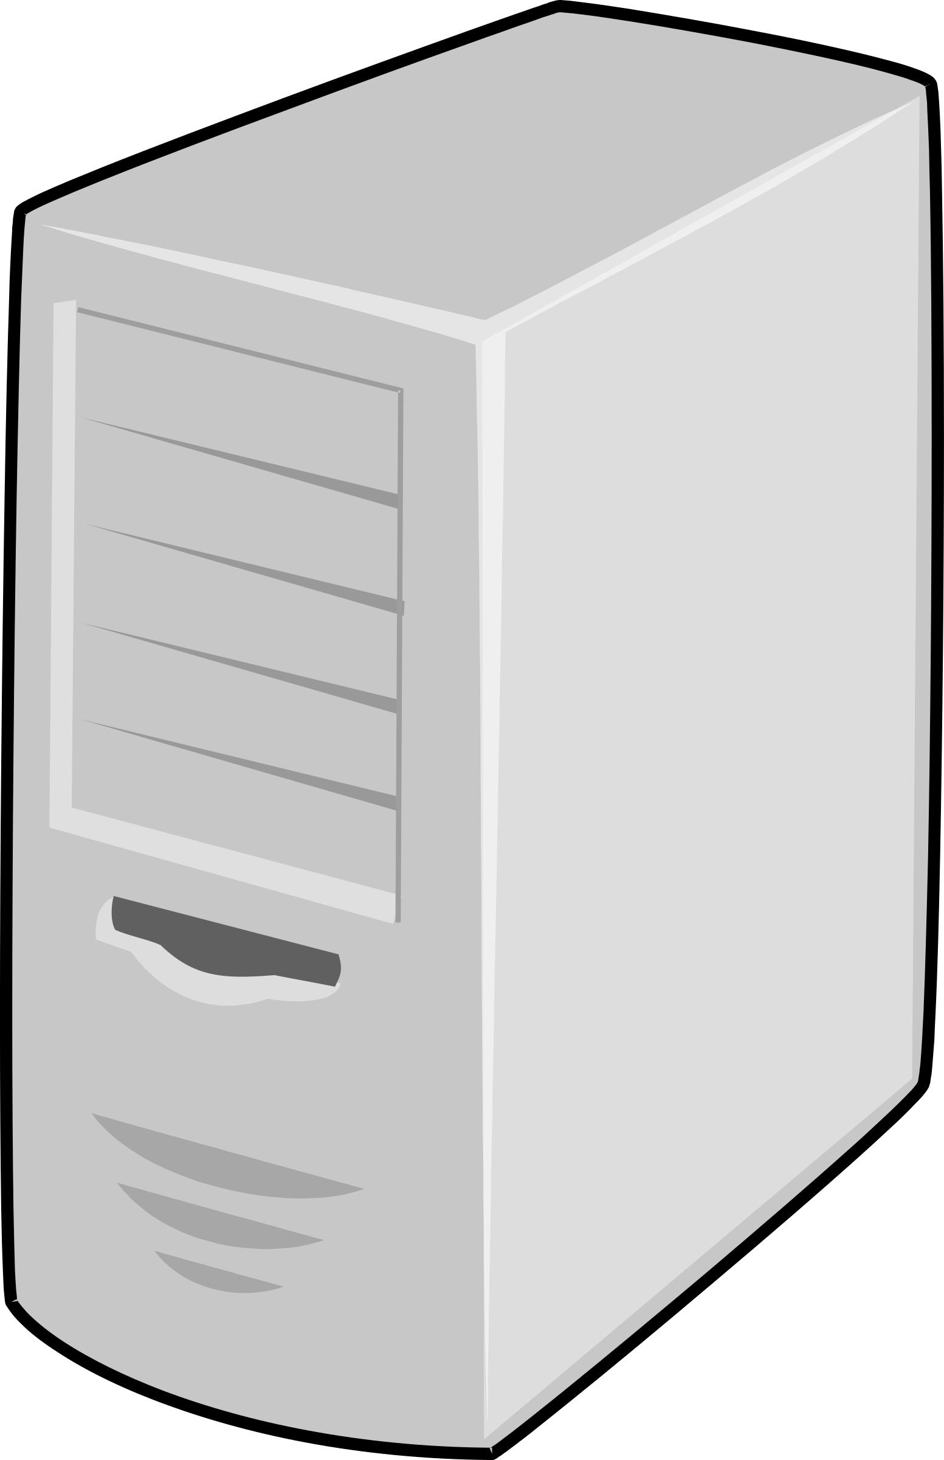
What does a Hadoop cluster look like?
Edge Nodes
Name Nodes
Data Nodes
Edge Nodes
Name Nodes
Data Nodes
Notes:
Bullet Points

Slide 8
Apache Hive with Hadoop
Hadoop Overview
Hive Overview
Practical Information
File Format
Theory
Lab and next time
Notes:
Bullet Points

Slide 9
What is Hive?
Data warehouse software that facilitates reading, writing, and managing large datasets residing in distributed storage using SQL
Structure can be projected onto data already in storage
Internally managed tables as well
Schema on read
A bit of data virtualization
Common use cases: Analytics and data transformation
Notes:
Bullet Points

Slide 10
What is Hive?
File formats:
Text files
CSV, TSV, any human readable delimited file
Columnar file formats
ORC
Parquet
Avro
JSON
Access:
CLI - From edge or remote
Client APIs - Python, Ruby etc
GUI - DBeaver, SQuirrel, SQLWorkbench/J, DBVisualizer, SQL Developer etc
Web UI - Hue, Ambari
JDBC
Notes:
https://cwiki.apache.org/confluence/display/Hive/HiveServer2+Clients

Slide 11
Apache Hive with Hadoop
Hadoop Overview
Hive Overview
Practical Information
File Format
Theory
Lab and next time
Notes:
Bullet Points

Slide 12
HiveQL
SQL-like language used to interact with Hive
Very similar to SQL in other traditional database applications (MSSQL, Oracle, PostgresQL, MySql etc)
What is schema on read?
The structure of the data is not checked (in Hive) until the data is read
Agile
Predefined structure is not needed before the consumption of data begins
Able to easily handle upstream changes without modifying schema before the data is consumed
Notes:
https://cwiki.apache.org/confluence/display/Hive/LanguageManual

Slide 13
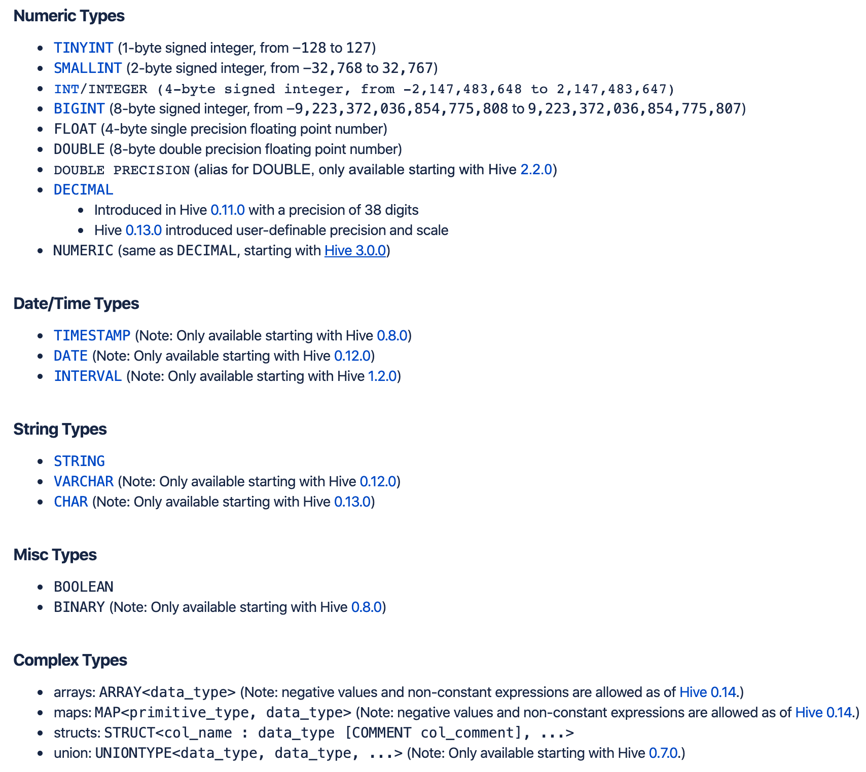
Data Types
Notes:
https://cwiki.apache.org/confluence/display/Hive/LanguageManual

Slide 14
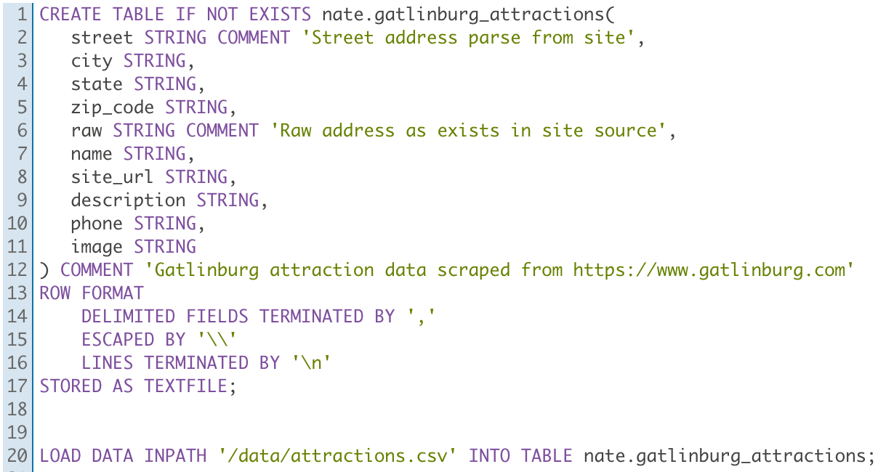
Data Definition Language - DDL
Given: CSV file, not quoted, commas escaped by “\”
Managed:
Notes:
https://cwiki.apache.org/confluence/display/Hive/LanguageManual
CREATE TABLE IF NOT EXISTS nate.gatlinburg_attractions(
street STRING COMMENT 'Street address parse from site’
city STRING,
state STRING,
zip_code STRING,
raw STRING COMMENT 'Raw address as exists in site source’,
name STRING,
site_url STRING,
description STRING,
phone STRING,
image STRING
) COMMENT ‘Gatlinburg attraction data scraped from https://www.gatlinburg.com"
ROW FORMAT
DELIMITED FIELDS TERMINATED BY ','
ESCAPED BY '\\"
LINES TERMINATED BY '\n"
STORED AS TEXTFILE;
LOAD DATA INPATH '/data/attractions.csv' INTO TABLE nate.gatlinburg_attractions;

Slide 15
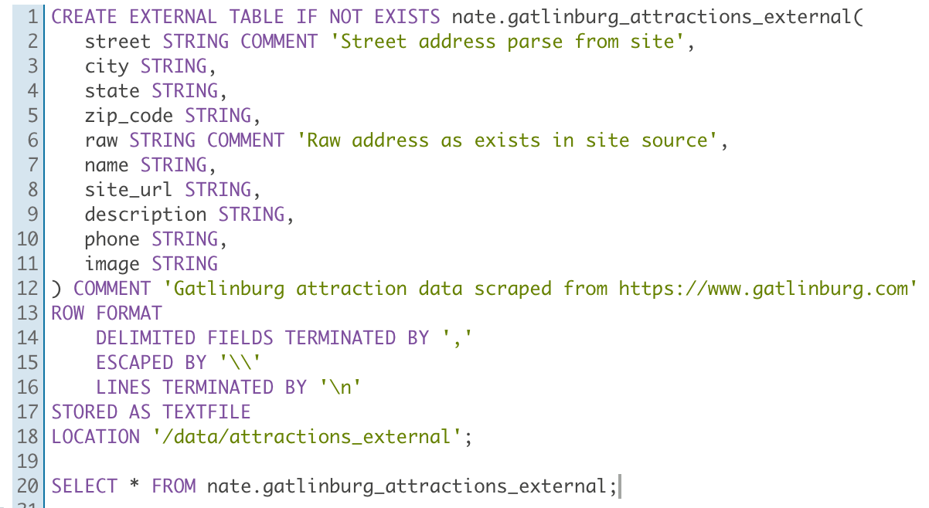
Data Definition Language - DDL
External:
Notes:
https://cwiki.apache.org/confluence/display/Hive/LanguageManual

Slide 16
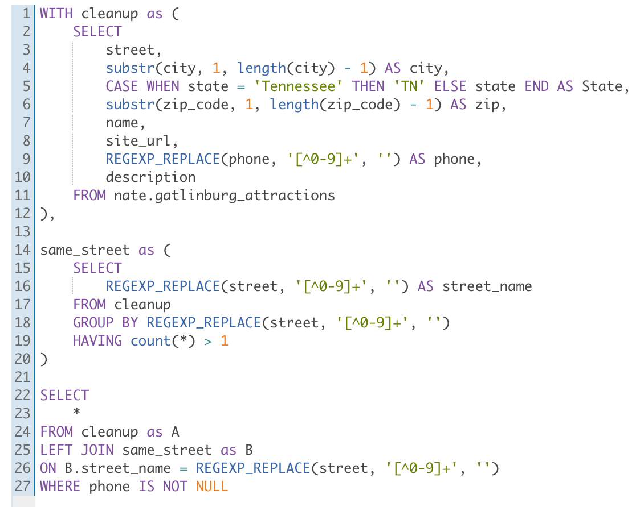
Data Retrieval
Select
Group By
User-Defined Functions (UDFs)
XPath-specific Functions
Joins
Join Optimization
Union
Lateral View
Analytical/Windowing
Sub-query
Common Table Expressions
Notes:
https://cwiki.apache.org/confluence/display/Hive/LanguageManual

Slide 17
Apache Hive with Hadoop
Hadoop Overview
Hive Overview
Practical Information
File Format
Theory
Lab and next time
Notes:
Bullet Points

Slide 18
File Format
Avro
Widely used as a serialization platform
Row-based, offers a compact and fast binary format
Schema is encoded on the file so the data can be untagged
Files support block compression and are splittable
Supports schema evolution
Parquet
Column-oriented binary file format
Uses the record shredding and assembly algorithm described in the Dremel paper
Each data file contains the values for a set of rows
Efficient in terms of disk I/O when specific columns need to be queried
Notes:
https://www.slideshare.net/StampedeCon/choosing-an-hdfs-data-storage-format-avro-vs-parquet-and-more-stampedecon-2015

Slide 19
Apache Hive with Hadoop
Hadoop Overview
Hive Overview
Practical Information
File Format
Theory
Lab and next time
Notes:
Bullet Points

Slide 20
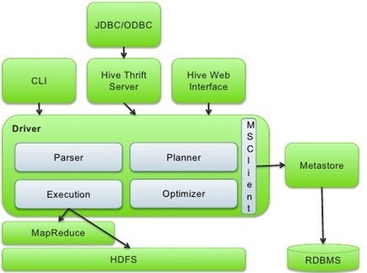
Architecture Overview
Notes:
Bullet Points

Slide 21
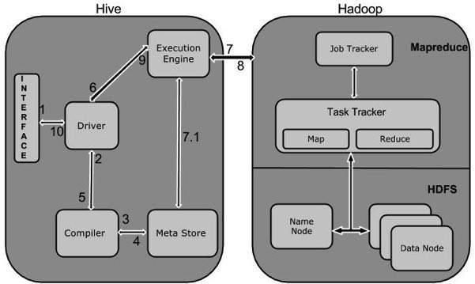
Architecture Overview
Notes:
https://www.tutorialspoint.com/hive/hive_introduction.htm

Slide 22
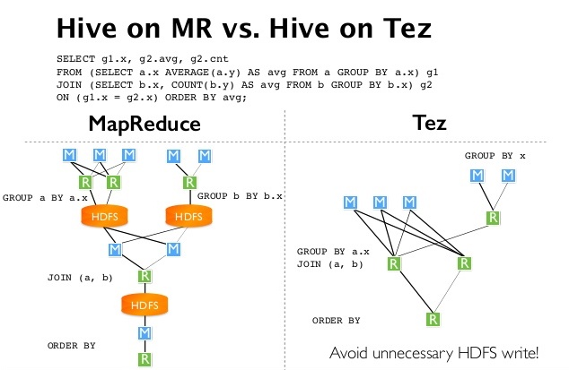
Execution Engines
Notes:
Bullet Points

Slide 23
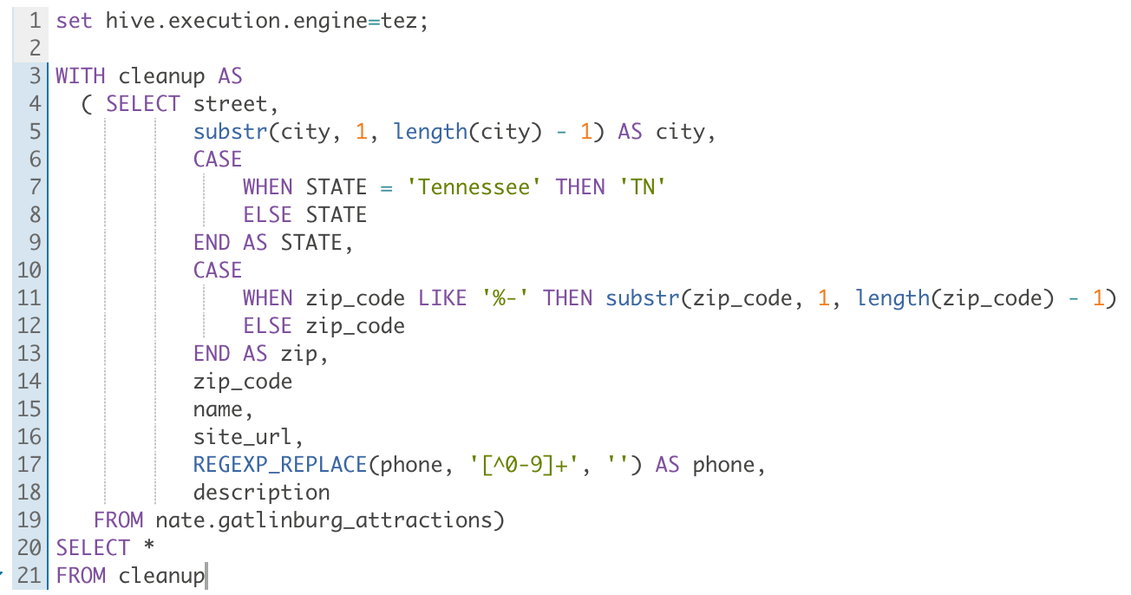
Hive Configuration Properties
There are a number of hive properties that can be modified at runtime
In the example below, you can see that we are modifying the execution engine for our session
Properties Detailed
Notes:
Bullet Points

Slide 24
Tables
Table Details:
External:
Managed:
Significance?
Managed tables copy the data into Hive
External tables point to the data
Dropping an external table does not delete the underlying data
Notes:
Bullet Points

Slide 25
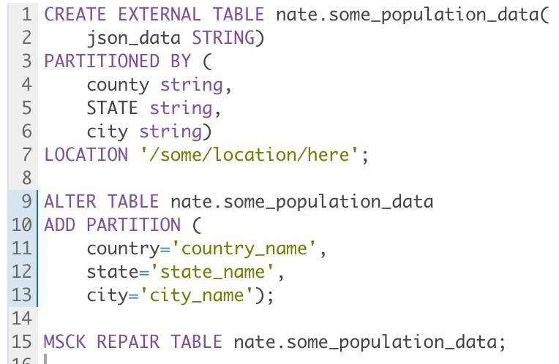
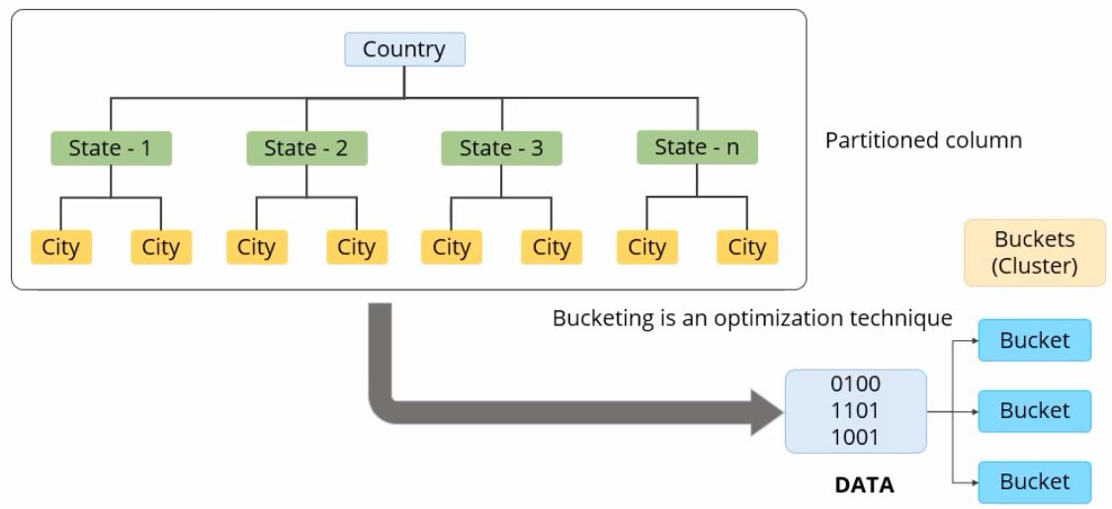
Partitioning
A technique used to divide into different parts based on the values in a given column
Partitioning can increase performance and maintainability of a table
Partitions are stored under directories specified within the table DDL
Notes:
Bullet Points

Slide 26
Apache Hive with Hadoop
Hadoop Overview
Hive Overview
Practical Information
File Format
Theory
Lab and next time
Notes:
Bullet Points

Slide 27
Hive Lab
Sign onto Hue: http://35.184.255.239:8888/. Next to the big blue "Query" button, click the drop down arrow and select Editor->Hive
Each user has a Hive database named $USER and 2 directories on HDFS:
/user/$USER/amazon_reviews_tsv
/user/$USER/amazon_reviews_json
Create an external table in your database on top of the TSV directory. How many reviews gave 2 stars? 5 stars?
Create an external table on top of the JSON directory. How many reviews were verified reviews?
Hint: use ROW FORMAT SERDE 'org.apache.hive.hcatalog.data.JsonSerDe'
Create a new/managed (ie, not external) table by using the CTAS (create table as) syntax to select all reviews with >3 stars.
Create a new/empty/managed table with the storage defined as Parquet. Insert/Select from either of your external tables into the managed Parquet table.
Notes:
Bullet Points

